Slide 1
AngularJS
AngularJS
Lecture 2
By James(Jin) Wang
08/01/2019

Slide 2
Outline
Data Binding Overview
Directives and Expressions
Iterating Over Data
Sorting and Formatting Data

Slide 3
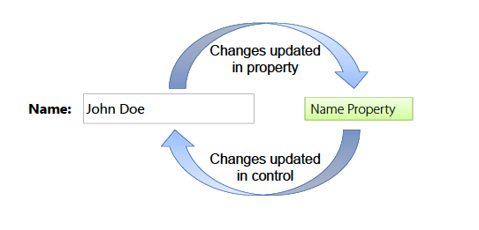
View, Directives and Filters
  Data Binding Overview:
  Javascript does’t provide native support for data binding
  Two-way data binding can lead to significant reductions in code

Slide 4
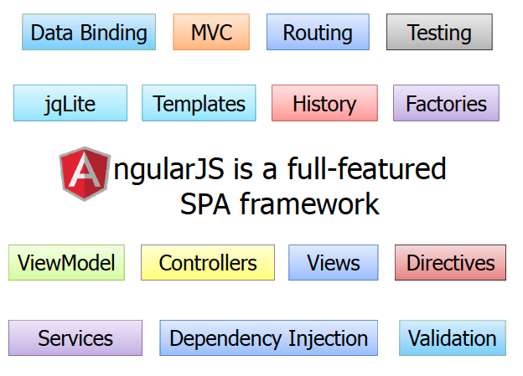
Big Picture
  Full-featured SPA Framework:

Slide 5
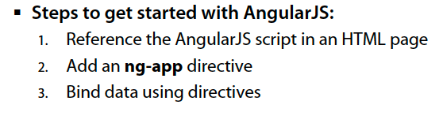
Big Picture
  Getting Started with AngularJS:

Slide 6
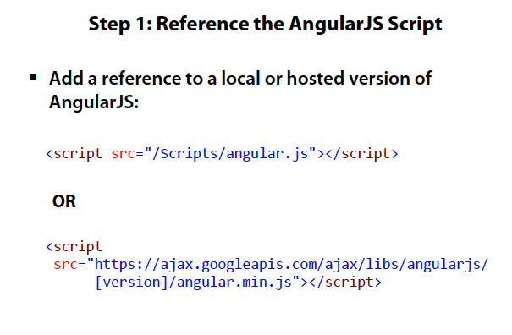
Big Picture

Slide 7
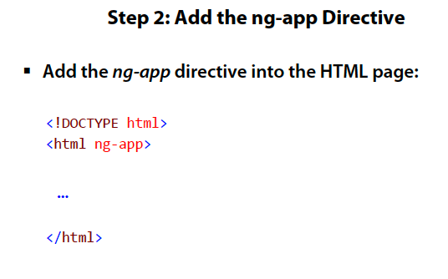
Big Picture

Slide 8
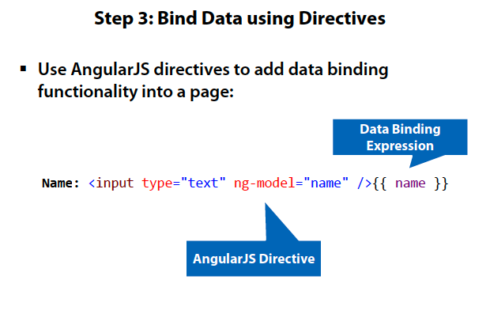
Big Picture

Slide 9
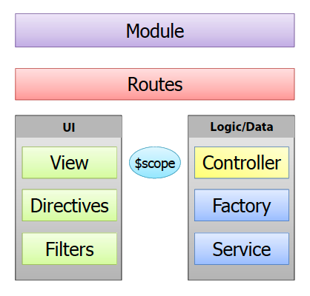
Big Picture
  Key Players in AngularJS:

Slide 10
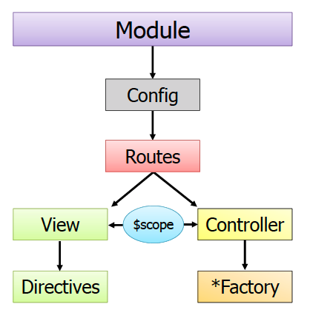
Big Picture
  The Big Picture:

Slide 11
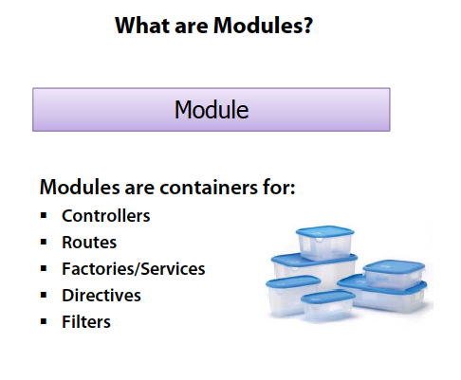
Big Picture

Slide 12
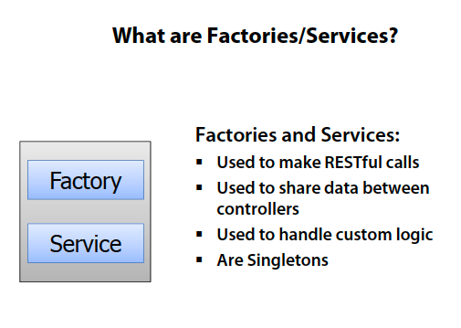
Big Picture

Slide 13
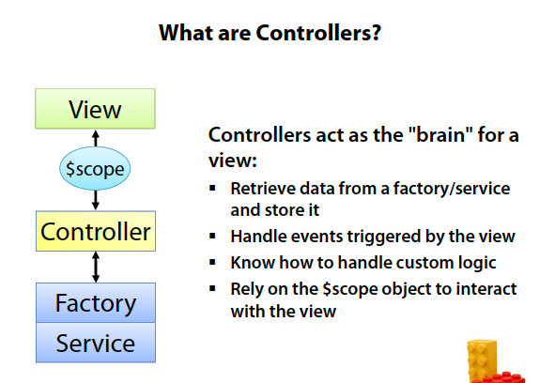
Big Picture

Slide 14
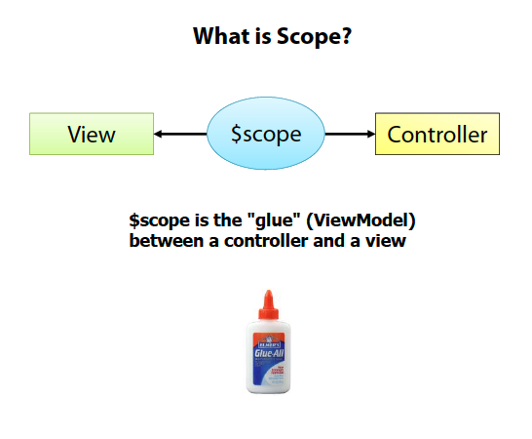
Big Picture

Slide 15
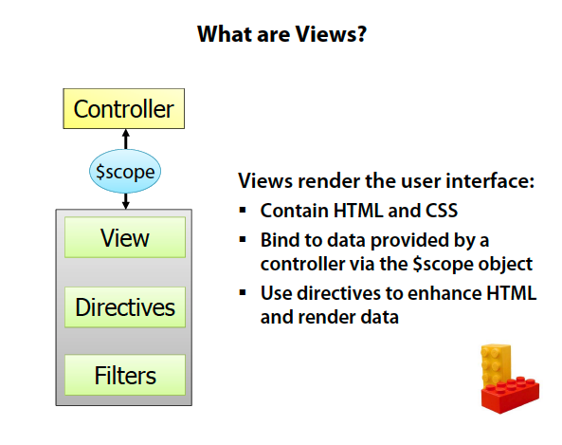
Big Picture

Slide 16
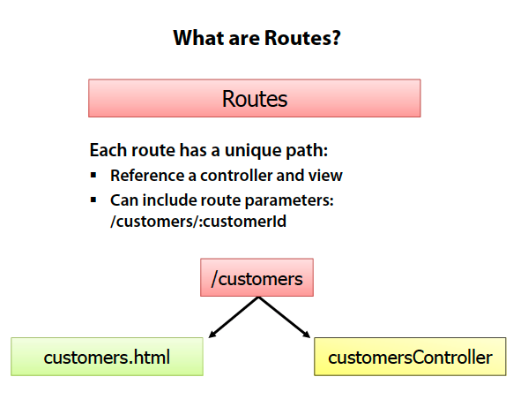
Big Picture

Slide 17

Big Picture
  https://docs.angularjs.org/api

Slide 18
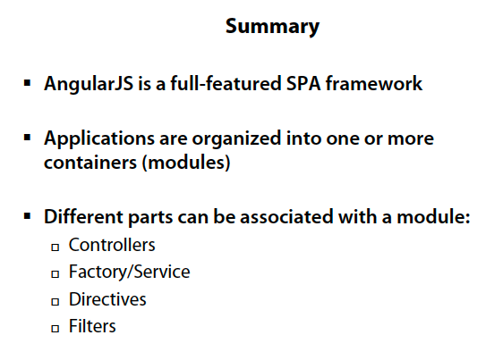
Big Picture

